Slide 1
Lecture 10 – Dynamic Routing
COMP1002 (Cybersecurity and Networks)

Slide 2
Objectives
Purpose, use, and functionality of routing protocols
Compare routing protocols
Describe distance vector routing protocols
Describe link-state routing protocols

Slide 3
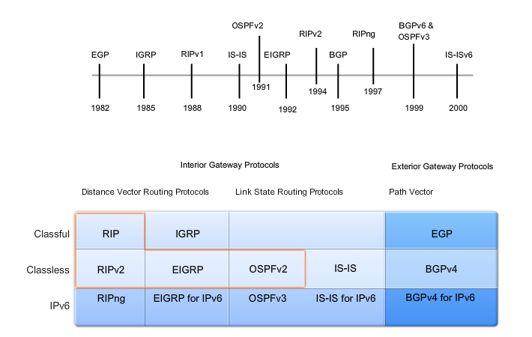
Routing protocols timeline

Slide 4
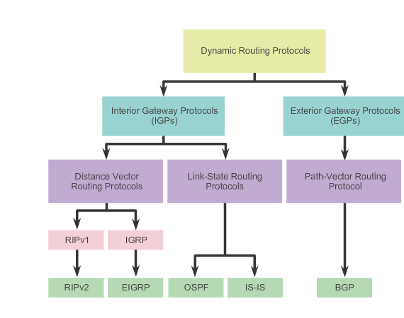
Types of dynamic routing protocols

Slide 5
Classifying routing protocols
Purpose – IGP or EGP (will explain in a bit)
Operation - Distance vector, link-state, or path-vector
Behaviour - Classful (legacy) or classless protocol
IPv4 routing protocols are classified as follows:
RIPv1 (legacy) - IGP, distance vector, classful protocol
IGRP (legacy) - IGP, distance vector, classful protocol developed by Cisco
RIPv2 - IGP, distance vector, classless protocol
EIGRP - IGP, distance vector, classless protocol developed by Cisco
OSPF - IGP, link-state, classless protocol
IS-IS - IGP, link-state, classless protocol
BGP - EGP, path-vector, classless protocol

Slide 6
Purpose of routing protocols
Discovery of remote networks
Maintaining up-to-date routing information
Choosing the best path to destination networks
Ability to find a new best path if the current path is no longer available
Components
Data structures
Algorithm
Routing protocol messages

Slide 7
ASes
Autonomous system (AS) - collection of routers under a common administration.
a company internal networks, ISPs.
Two types of routing protocols
Interior Gateway Protocols (IGP) - intra-autonomous system routing - routing inside an autonomous system.
Two types: Distance vector or Link state
Exterior Gateway Protocols (EGP) - inter-autonomous system routing - routing between autonomous systems.

Slide 8
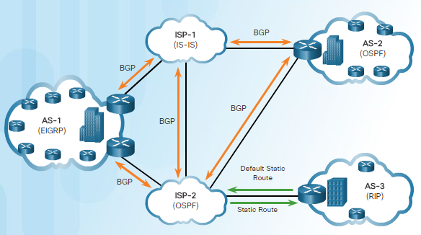
IGP vs EGP

Slide 9
IGP vs EGP
IGPs: RIP, IGRP, EIGRP, OSPF, IS-IS.
Based on a metric
RIP – hop count
OSPF – a range of metrics, e.g. bandwidth
EGPs: BGP
BGP - path vector protocol that can use many different attributes to measure routes.
fastest path may be a secondary issue
Typically based on policies

Slide 10
Router operation
Sends and receives routing messages on its interfaces.
Shares routing messages and routing information with other routers that are using the same routing protocol.
Exchange routing information to learn about remote networks.
When detecting a topology change - advertise this change to other routers.

Slide 11
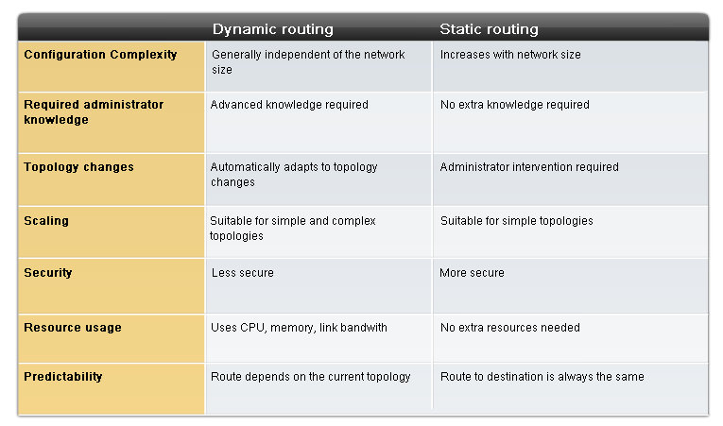
Dynamic vs static routing

Slide 12
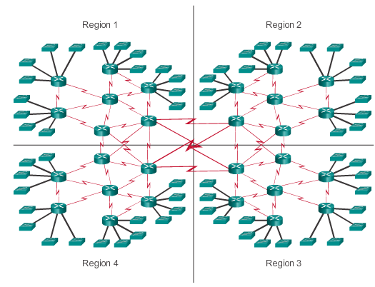
Dynamic routing scenario

Slide 13
Dynamic routing protocol operation
The router sends and receives routing messages on its interfaces.
The router shares routing messages and routing information with other routers that are using the same routing protocol.
Routers exchange routing information to learn about remote networks.
When a router detects a topology change the routing protocol can advertise this change to other routers.

Slide 14
Distance vector vs link state
DVRP - are like road signs
Routers must make preferred path decisions based on a distance or metric to a network.
Just as travellers trust a road sign to accurately state the distance to the next town, a distance vector router trusts that another router is advertising the true distance to the destination network.
LSRP - are like a road map
Create a topological map of the network and each router uses this map to determine the shortest path to each network.
Just as a map is referred to when finding the route to another town, link-state routers use a map to determine the preferred path to reach another destination.

Slide 15
Distance vector protocols
Routes advertised as vectors of distance and direction.
Distance is defined using a metric (e.g. hop count)
Direction is the next-hop router or exit interface.
Typically use the Bellman-Ford algorithm for the best path route determination.
eventually accumulates enough knowledge to maintain a database of reachable networks,
…but it does not allow a router to know the exact topology of an internetwork.
Router only knows routing information from neighbors.

Slide 16
Link state protocols
Router creates "complete view"
Topology of the network by gathering information from all of the other routers.
Complete map of the network topology.
All link-state routers are using an identical "map" of the network.
Router uses the link-state information to create a topology map select the best path to all destination networks in the topology

Slide 17
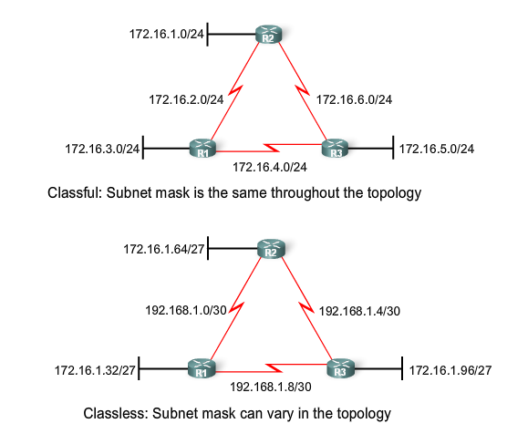
Classful vs classless routing

Slide 18
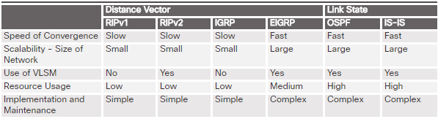
Routing protocol characteristics

Slide 19
Metric
Routing protocols must evaluate and differentiate between the available paths.
Best path is selected using a metric - value which assigns costs to reach remote networks.
The metric is used to determine which path is most preferable when there are multiple paths to the same remote network.
Each routing protocol uses its own metric.

Slide 20
Metrics
Hop count - number of routers a packet must traverse
Bandwidth - the path with the highest bandwidth
Load - traffic utilization of a certain link
Delay - the time a packet takes to traverse a path
Reliability - the probability of a link failure, calculated from the interface error count or previous link failures
Cost - A value determined either by the IOS or by the network administrator to indicate preference for a route.

Slide 21
Best path metrics
RIP: Hop count - the route with the lowest hop count.
IGRP and EIGRP: Bandwidth, Delay, Reliability, and Load - the route with the smallest composite metric value calculated from these multiple parameters.
By default, only bandwidth and delay are used.
OSPF: Cost - the route with the lowest cost. Cisco's implementation of OSPF uses bandwidth.
EIGRP
k1-k5 – parameters
b – bandwidth
d – delay
l – load
r - reliability

Slide 22
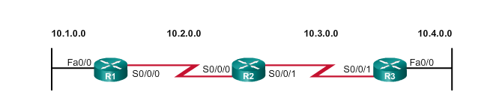
Cold start and network discovery
Routers initially hold information about their directly connected networks
Through information exchange, they discover the network and populate their routing tables

Slide 23
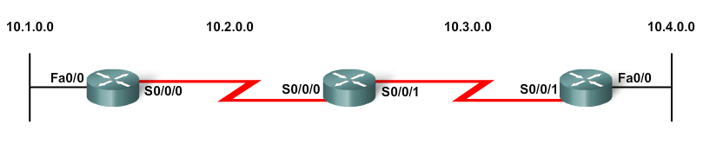
Cold start

Slide 24
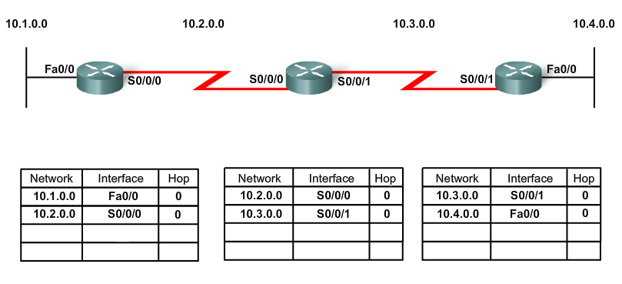
Network discovery

Slide 25
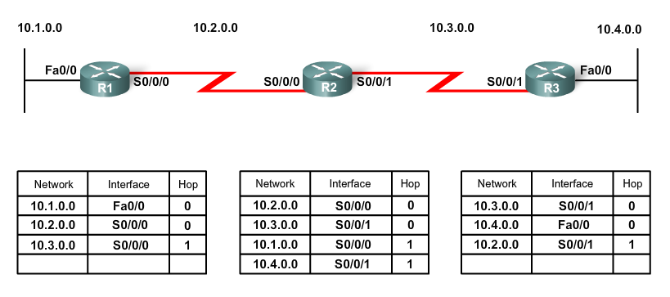
Initial exchange

Slide 26
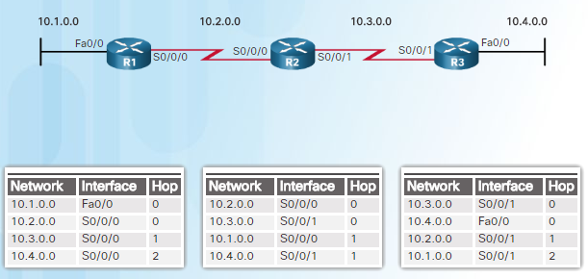
Converged network

Slide 27
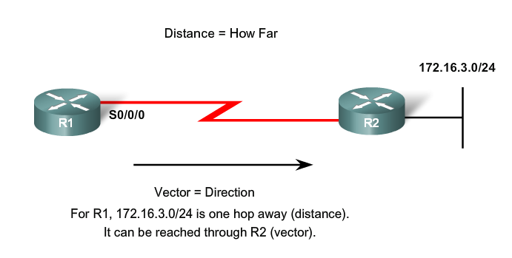
The meaning

Slide 28
Routing protocol algorithm
Algorithm - calculate best paths
To be used both locally and sent to neighbours
Involves mechanisms for
sending and receiving routing information.
calculating best paths
installing routes in the routing table.
detecting and reacting to topology changes.

Slide 29
DVRP characteristics
Time to Convergence - how quickly routers share routing information and reach consistent knowledge.
The faster the convergence, the more preferable the protocol.
Routing loops – due to inconsistent routing tables, slow convergence
Scalability - how large a network can become
The larger the network, the more scalable DVRP needs to be.
Classless or Classful
Classless DVRP include subnet mask in the updates.
Classful DVRP do not include subnet mask – no VLSM support
Resource Usage - CPU and link bandwidth utilisation
Implementation and Maintenance - level of knowledge required for an administrator
Run the network based on the DVRP deployed.

Slide 30
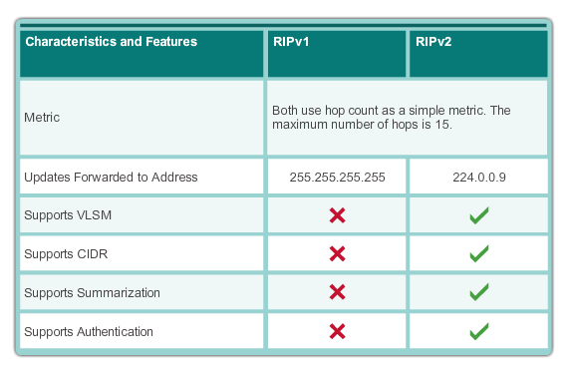
RIPv1 vs RIPv2

Slide 31
Link-state Routing Protocol (LSRP)
Aka shortest path first protocols
Built on Edsger Dijkstra's shortest path first (SPF) algorithm.
LSRP:
Open Shortest Path First (OSPF)

Slide 32
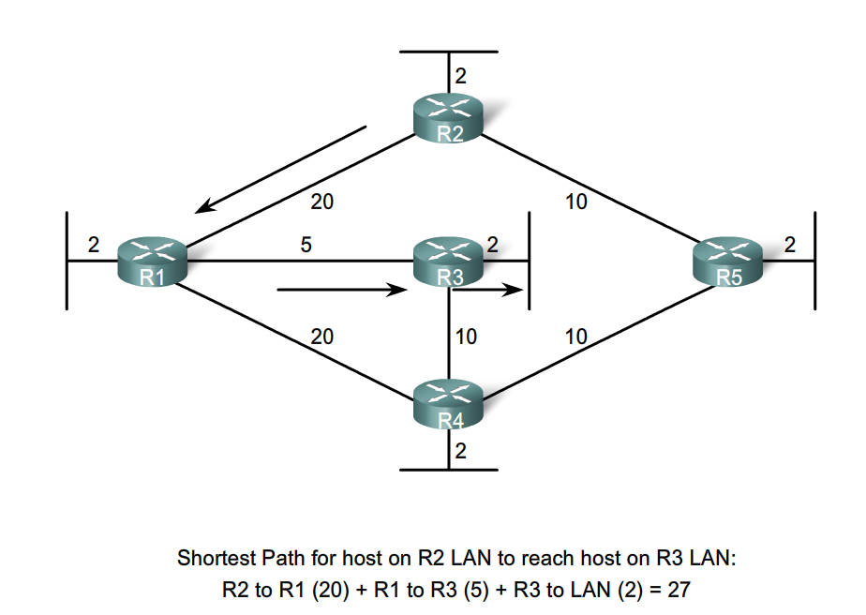
SPF algorithm – example

Slide 33
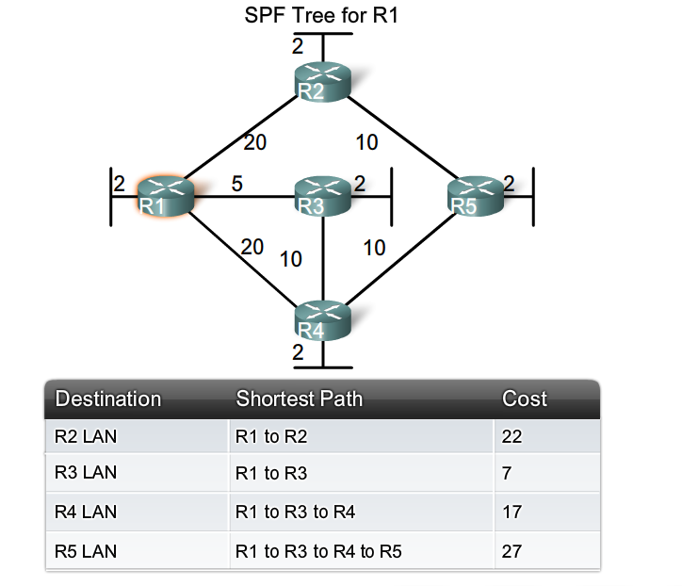
SPF example – R1

Slide 34
LSR process
Learns about own links/connected networks.
Through detecting interfaces in the up state.
Meet neighbours on directly connected networks.
Hello packets with LS routers on directly connected networks.
Build a Link-State Packet (LSP) - state of each directly connected link.
Record info about each neighbour: ID, link type, bandwidth.
Flood LSP to all neighbours, who then store all LSPs received in a database.
Neighbours then flood LSPs to their neighbours until all routers in the area have received the LSPs.
Use database to construct a complete map of the topology and compute best path to each network.
Complete map of all destinations in the topology and the routes to reach them.
The SPF algorithm is used to construct the map of the topology and to determine the best path to each network.

Slide 35
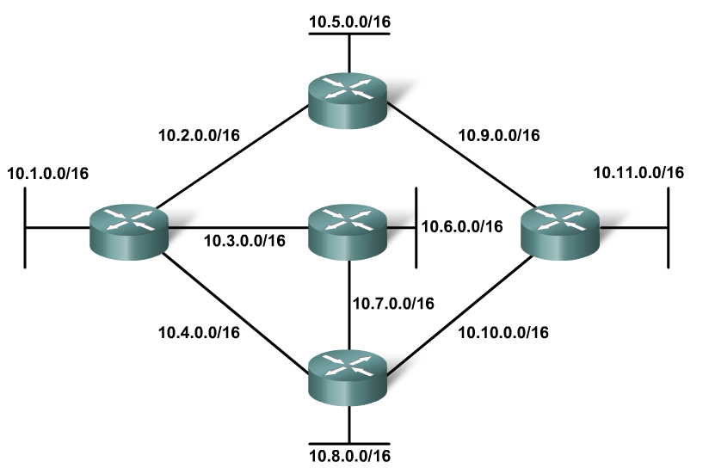
LSR process example - topology

Slide 36
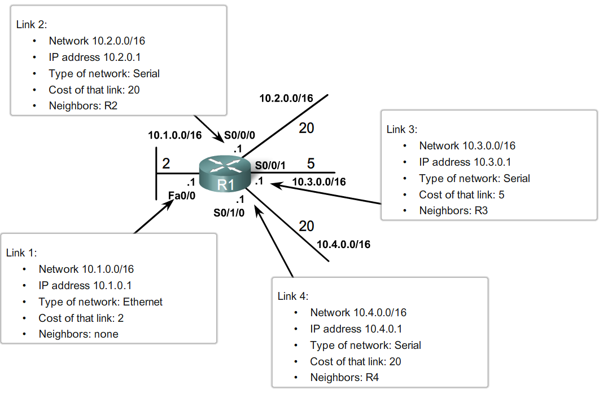
LSR process – step 1

Slide 37
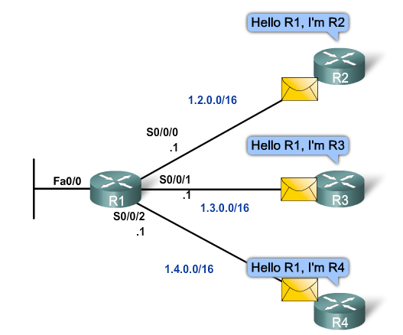
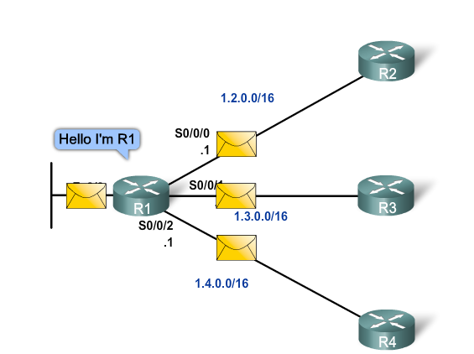
LSR process – step 2

Slide 38
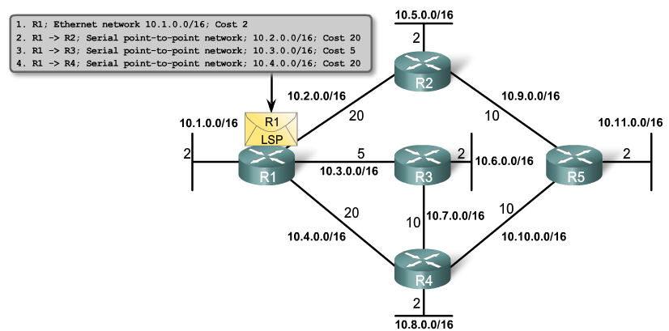
LSR process – step 3

Slide 39
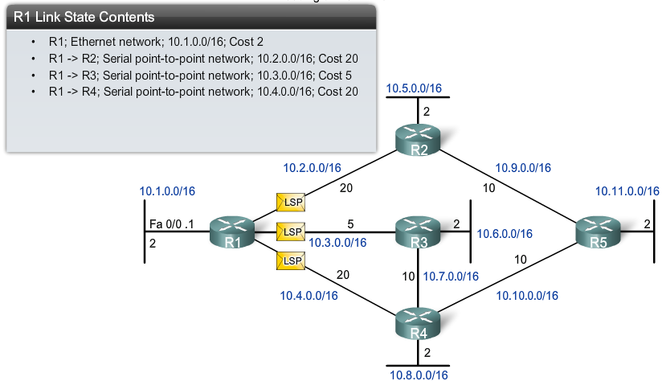
LSR process – step 4

Slide 40
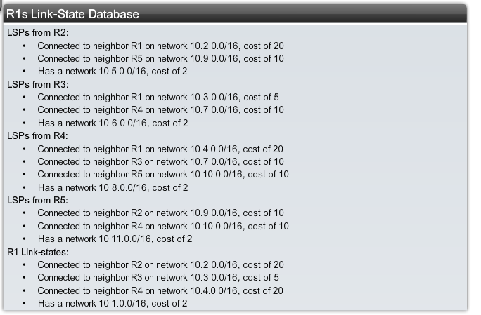
LSR process – step 5

Slide 41
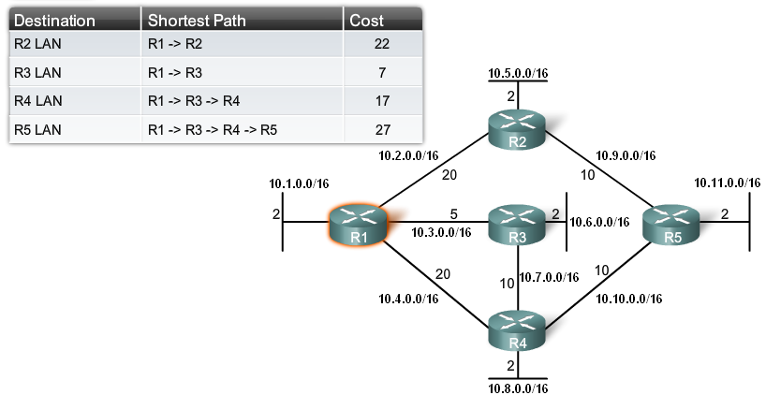
LSR process – step 5

Slide 42
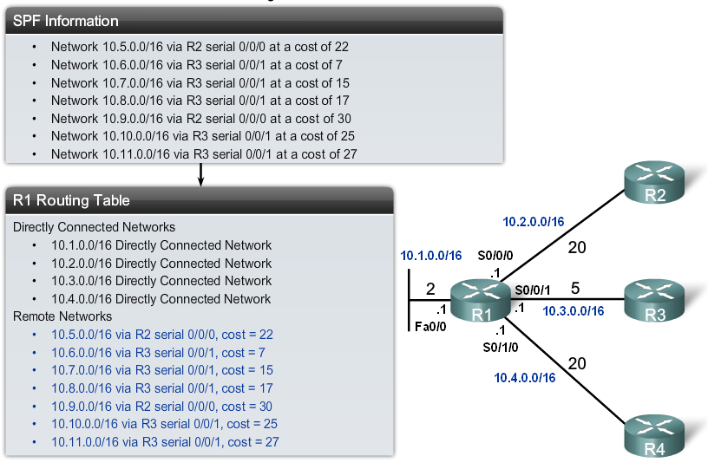
LSR process – step 5

Slide 43
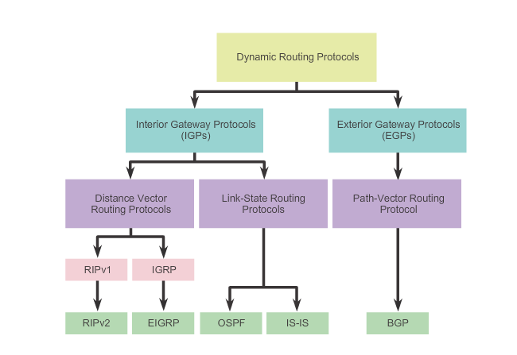
Summary

